Slide 1

Final Project Sentiment Analysis and Topic Modeling
Max Wienandts
CSCI S-89 Introduction to Deep Learning
Summer 2023
Harvard Summer School

Slide 2
Introduction
Problem statement: “Is BERT and DistilBERT appropriate to sentiment analysis? Is Latent Dirichlet Allocation (LDA) appropriate for topic modeling?”
Identify the sentiment of a review:
Baseline model LSTM (Long Short-Term Memory);
BERT (Bidirectional Encoder Representation from Transformers);
DistilBERT (a distilled version of BERT).
Identify the topic of a review:
LDA (Latent Dirichlet Allocation).
Dataset: 838,566 positive and negative company reviews from Glassdoor:
https://www.kaggle.com/datasets/davidgauthier/glassdoor-job-reviews?sort=most-comments
Python libraries:
json; pickle; time; numpy; pandas;
matplotlib; seaborn; wordcloud; pyLDAvis
re; nltk (it is necessary to download stopwords); genshim;
scikit-learn (sklearn); tensorflow (Step-by-step instructions: https://www.tensorflow.org/install/pip?hl=en); transformers.

Slide 3
Dataset
Jupyter notebook: 1 ETL and EDA.ipynb.
Dataset: 838,566 positive and negative company reviews from Glassdoor:
https://www.kaggle.com/datasets/davidgauthier/glassdoor-job-reviews?sort=most-comments
Every row has one positive and one negative review.
Preprocess and cleaning the data:
Make a table so every row has the name of the company, one review, and the sentiment of the review (positive or negative);
Drop missing values (from 1,677,132 rows, only 15 had missing values);
Substitute special characters such as “\r” and “\n” by blank space;
Drop line with only punctuations.
1,676,974 observations:
838,553 (50%) positive reviews;
838,421 (50%) negative reviews.

Slide 4
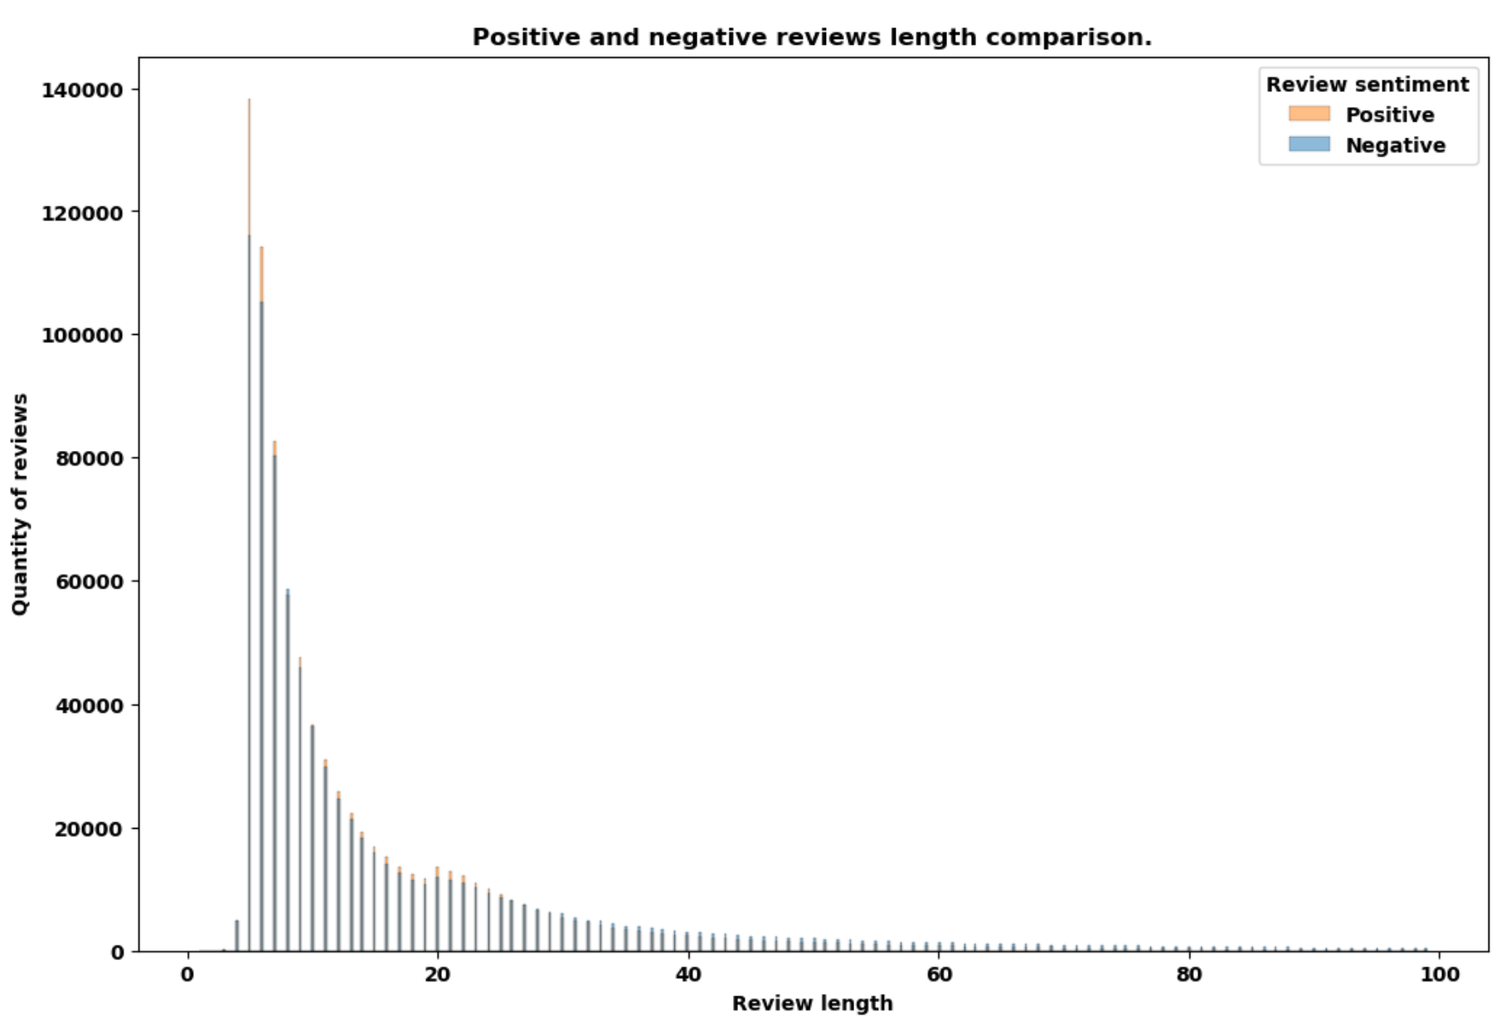

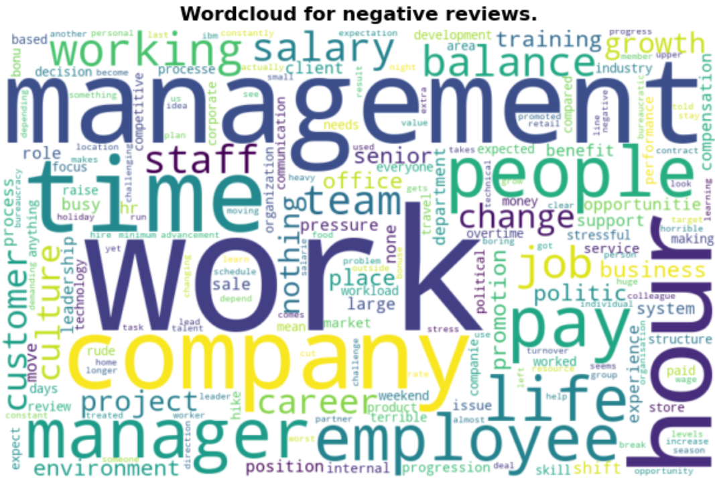
Exploratory Data Analysis
Review length
Mean | 18.58 | Standard Deviation | 32.82
Minimum | 1 | Maximum | 31720
25th Percentile | 6 | 50th Percentile | 9
75th Percentile | 20 | 95th Percentile | 57
Wordcloud Preprocessing:
Lower case;
Remove punctuation;
Remove stopwords (here, it was used the nltk library);
Remove some words that are not relevant to our study in specific.

Slide 5
Methodology
Jupyter notebook (LSTM, BERT, DistilBERT): 2 LSTM BERT DistilBERT.ipynb.
Jupyter notebook (LDA): 3 Topic modeling.ipynb.
20% of the dataset (335,395) was separated for test.
20% of the remaining (268,316) was separated for validation.
The rest of the dataset (1,073,263) was used to train.
All sentiment analysis models considered a maximum length of 60 for the reviews.
Long Short-Term Memory (LSTM):
Avoids vanishing and exploding gradients;
“selective persistent short-term memory” – Andrew Glassner, Deep Learning a Visual Approach.
Advantages:
Simple to implement;
Fast to train.
Disadvantages:
Does not capture all the relationship among words in a sentence;
May have poor performance.

Slide 6
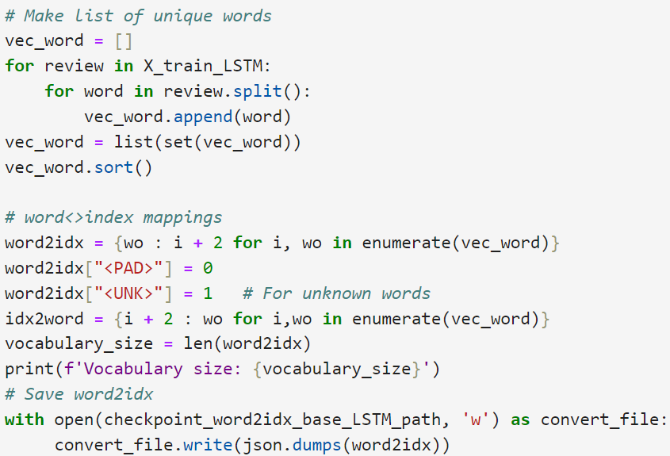
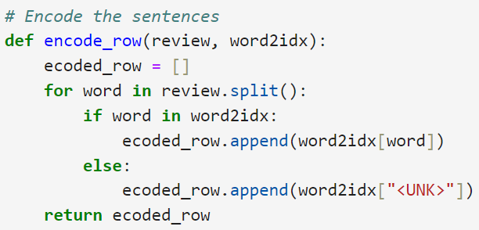
Long Short-Term Memory (LSTM)
Preprocessing:
Remove punctuation;
Create a vocabulary, adding values for padding, and unknown words;
Encode the reviews transforming each word in a number defined in the previous step;
Pad and truncate the reviews so all the observations have the same length;
You may add new steps such as put all words in lower case, and stemming or lemmatization. However, with enough observations, these are not crucial.

Slide 7
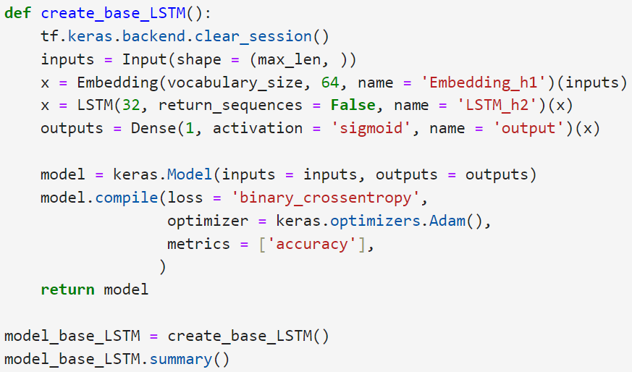
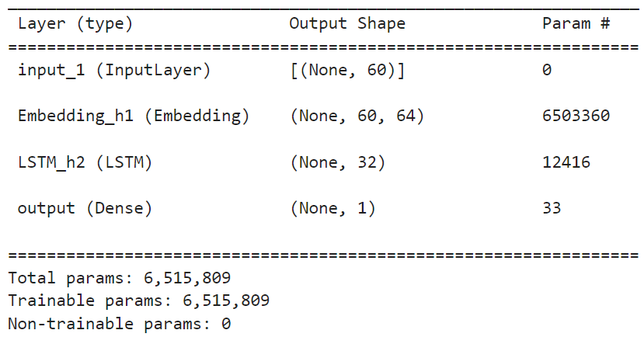
Long Short-Term Memory (LSTM)

Slide 8
Bidirectional Encoder Representations from Transformers (BERT)
Bidirectional Encoder Representations from Transformers (BERT)
Uses transformers blocks;
General-purpose language model;
Advantages:
It considers the impact of every word on every other word.
Its is already trained and can be used in other problems with transfer learning;
It is possible to fine-tune.
Disadvantages:
Even using transfer learning, it takes a long time to train;
Requires a considerable processing power, preferably a GPU with large VRAM.

Slide 9
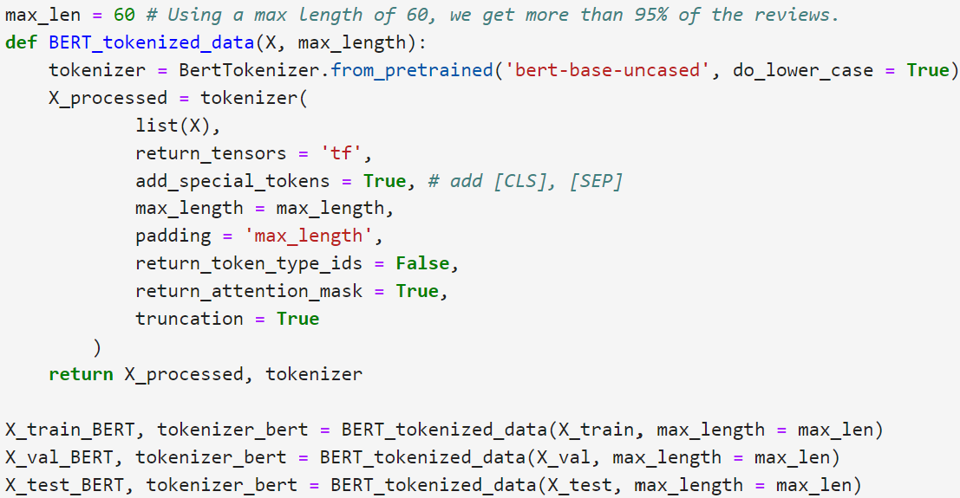
Bidirectional Encoder Representations from Transformers (BERT)
Preprocessing:
Use the correct tokenizer from the transformer library, it automatically preprocess with:
Lower case;
Separates punctuation;
Encode the message with its own vocabulary;
Adds special tokens CLS and SEP;
Pads and truncate the reviews

Slide 10
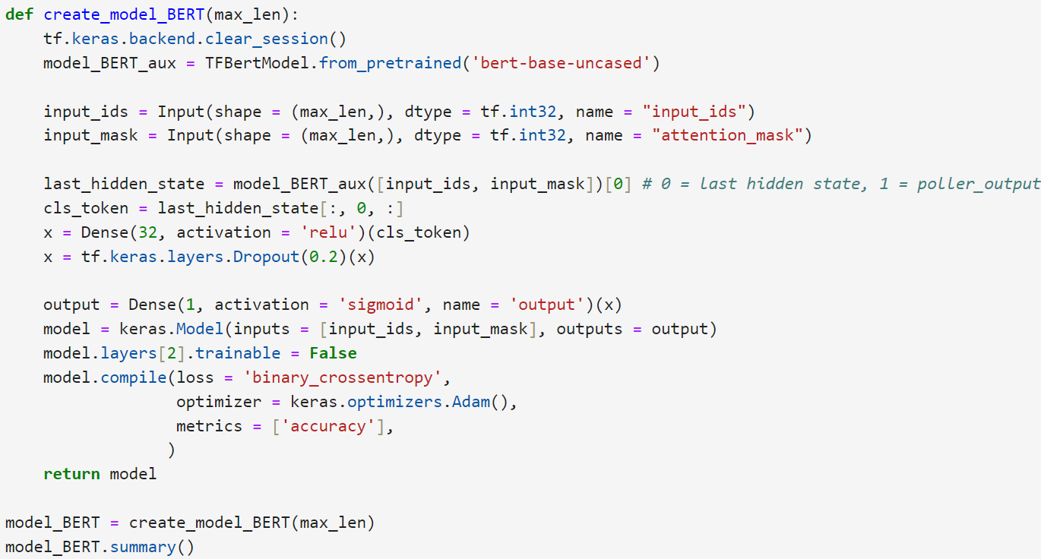
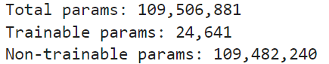
Bidirectional Encoder Representations from Transformers (BERT)

Slide 11
DistilBERT (a distilled version of BERT)
DistilBERT (a distilled version of BERT)
HuggingFace (https://huggingface.co/docs/transformers/model_doc/distilbert): “small, fast, cheap, and light Transformer model trained by distilling BERT base”.
Advantages:
Its is already trained and can be used in other problems with transfer learning;
It is possible to fine-tune;
Runs 60% faster than BERT, maintaining 95% of its performance.
Disadvantages:
it still takes a long time to train;
It still requires a considerable processing power, preferably a GPU with large VRAM.

Slide 12
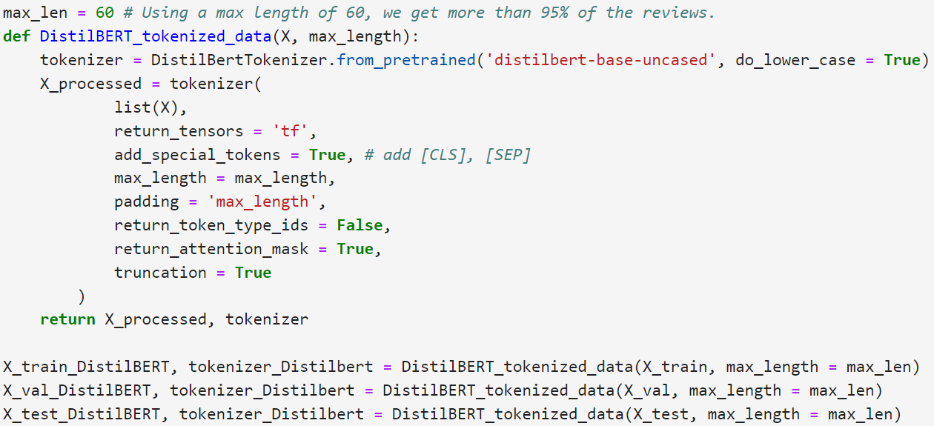
DistilBERT (a distilled version of BERT)
Preprocessing:
Use the correct tokenizer from the transformer library, it automatically preprocess with:
Lower case;
Separates punctuation;
Encode the message with its own vocabulary;
Adds special tokens CLS and SEP;
Pads and truncate the reviews

Slide 13
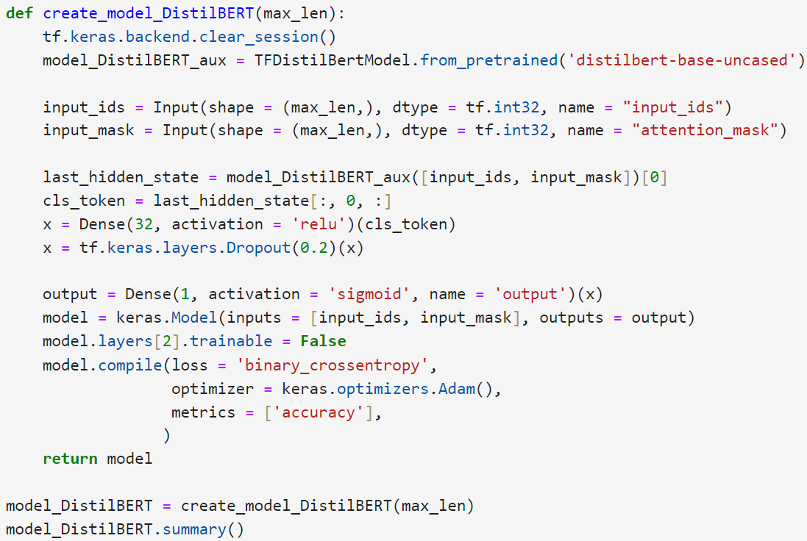
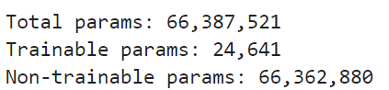
DistilBERT (a distilled version of BERT)

Slide 14
Latent Dirichlet Allocation (LDA)
Latent Dirichlet Allocation (LDA)
Unsupervised learning;
David M. Blei, Andrew Y. Ng and Michael I. Jordan, in your article Latent Dirichlet Allocation: “a generative probabilistic model for collections of discrete data such as text corpora”.
Advantages:
It is simply to use;
It is fast to train;
It does not require much computational power.
Disadvantages:
Does not consider the relationship among words;
It demands more preprocessing than other models;
Not all words defined as a topic have meaning;
May return topics that overlaps with another.

Slide 15
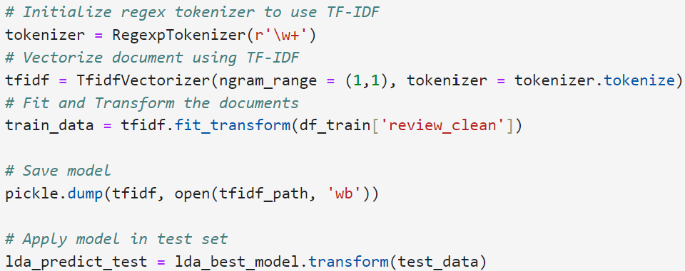
Latent Dirichlet Allocation (LDA)
Preprocessing:
Lower case all words;
Remove punctuations;
Remove stop words;
Remove frequent words that are not appropriate to be used as topic;
Tokenize the reviews in unigrams;
Stem or lemmatize the words (in this study it was used stemming);
Count the number of times that each word appears in one document, or vectorize the words using TF-IDF.

Slide 16
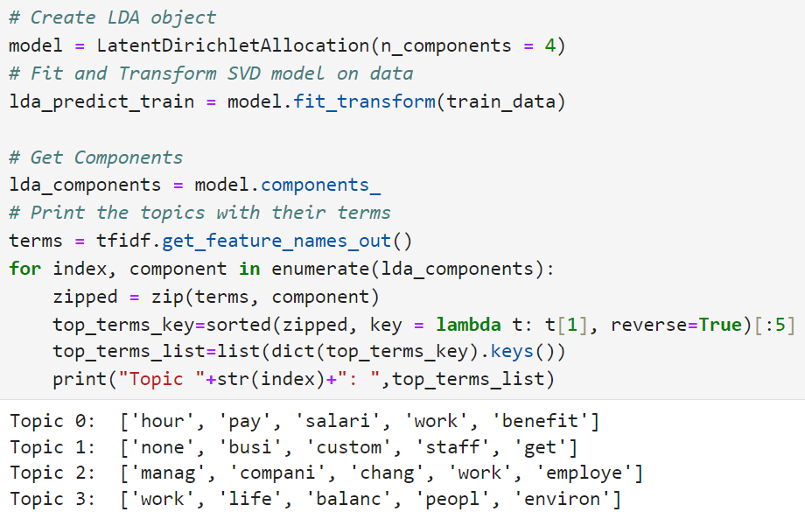
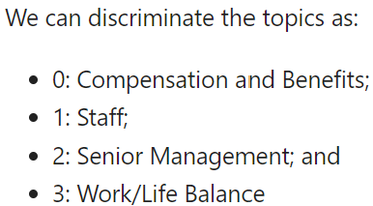
Latent Dirichlet Allocation (LDA)

Slide 17
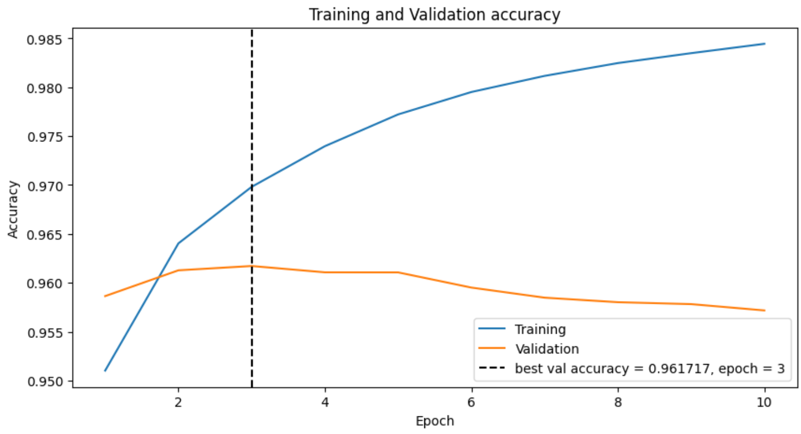
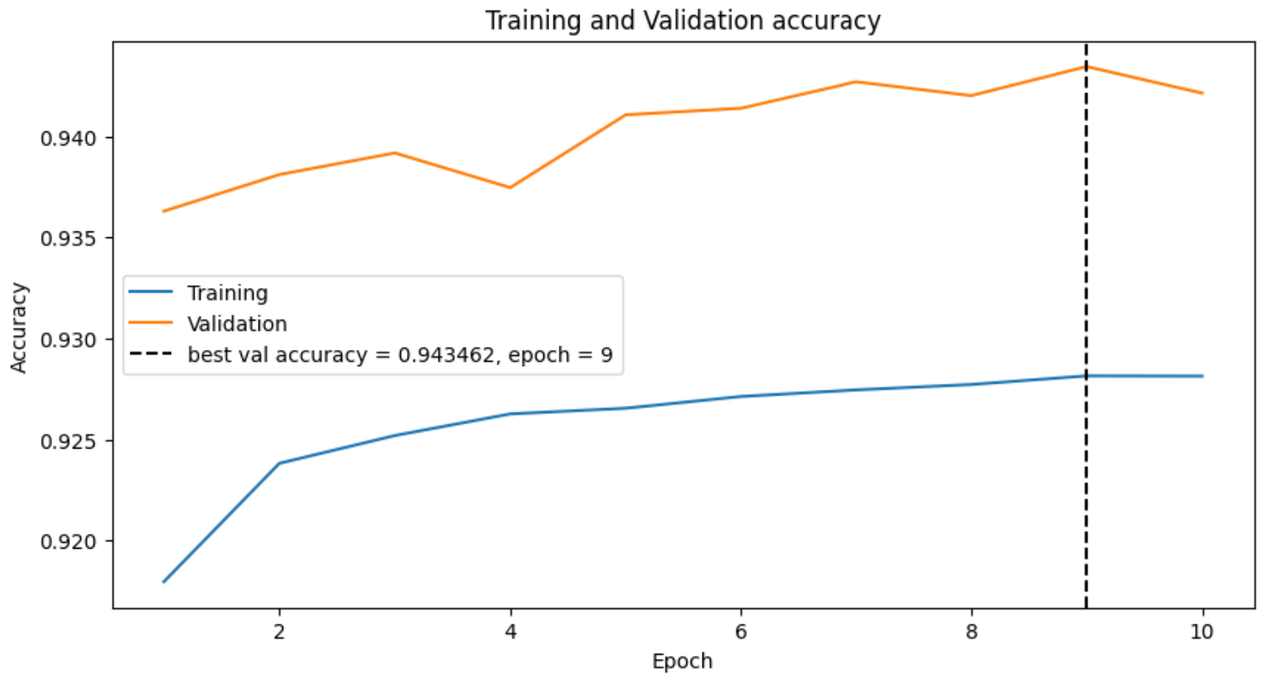
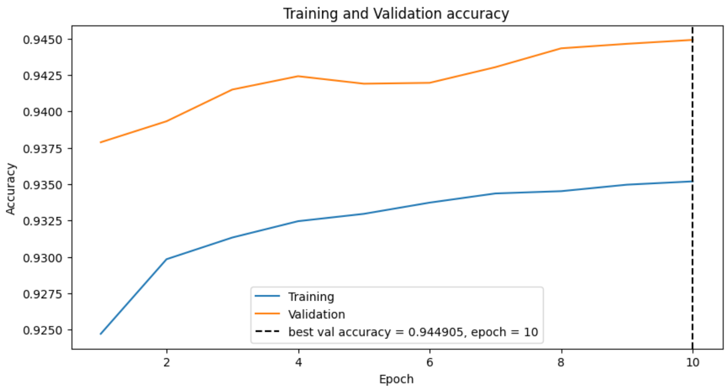
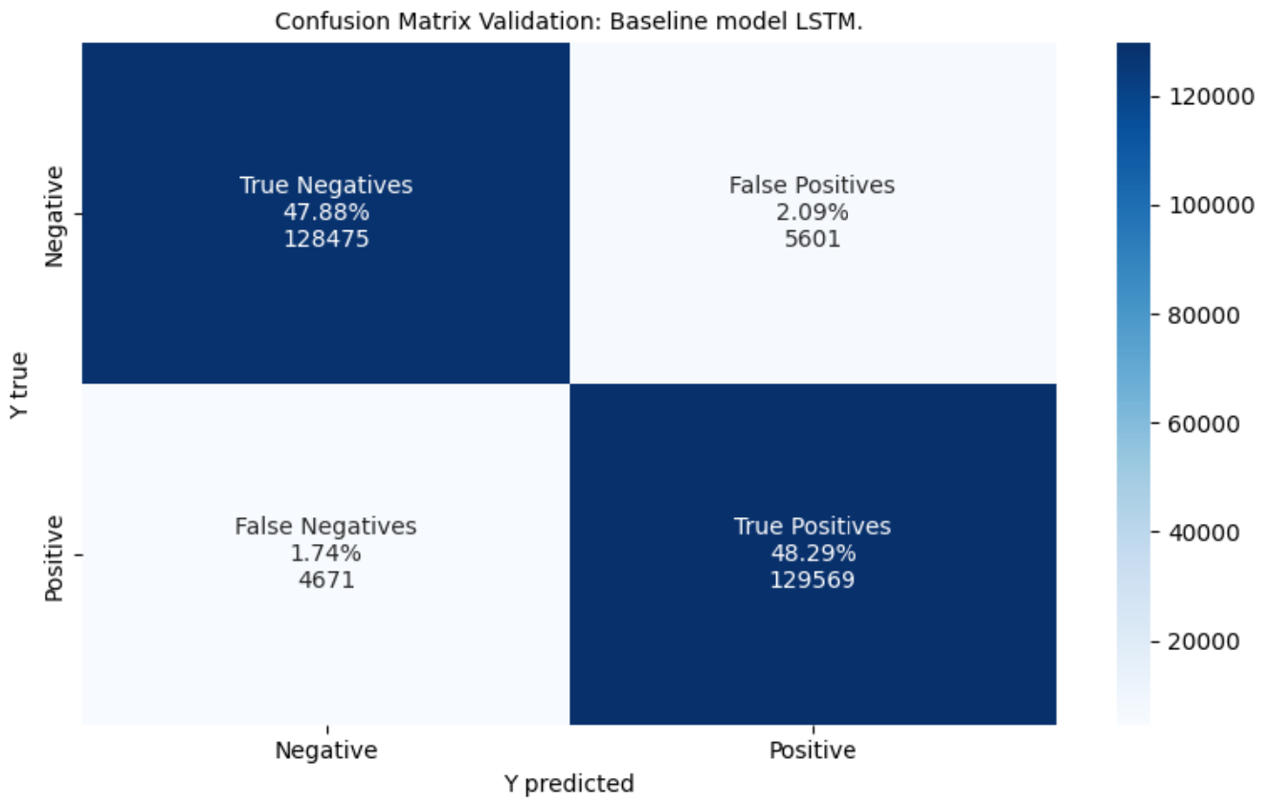
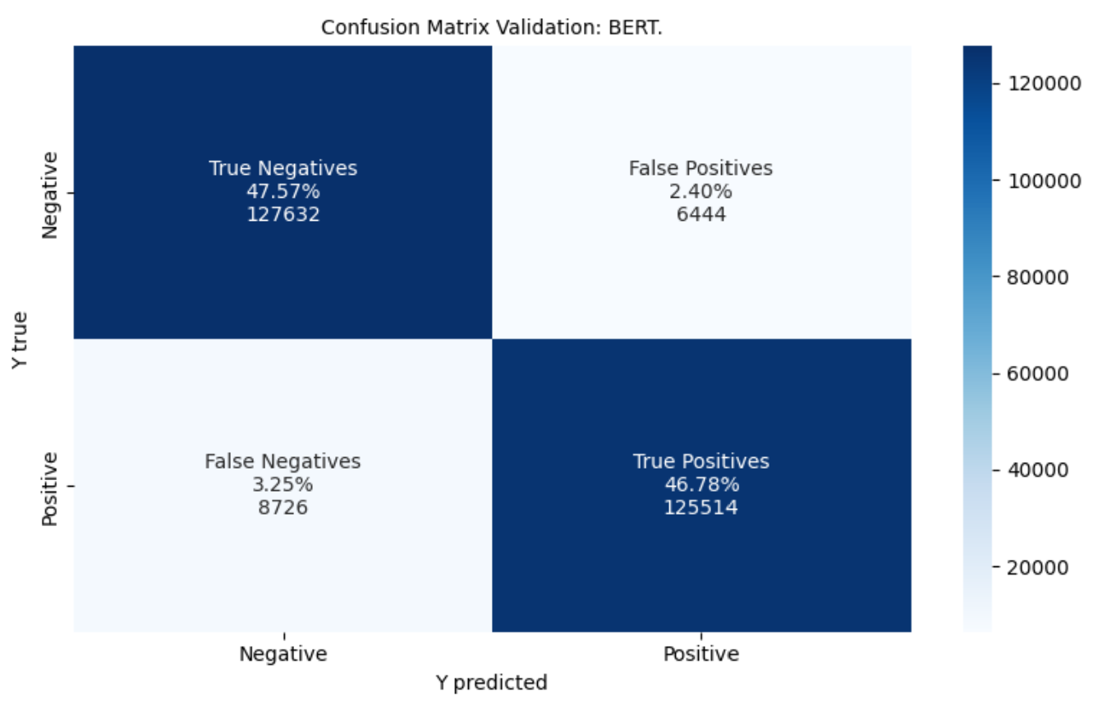
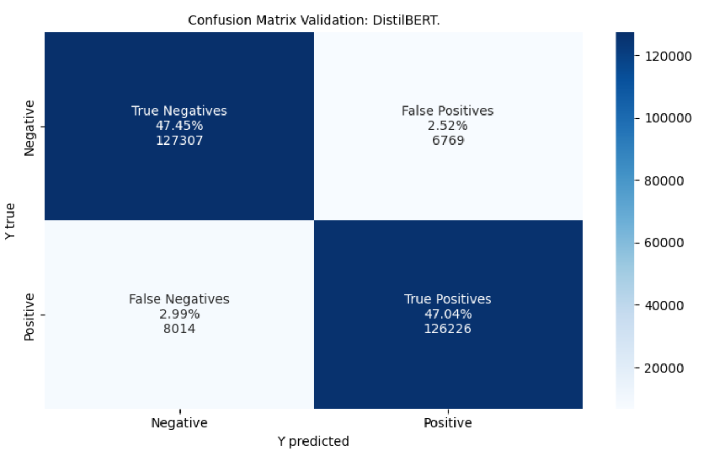
Results
LSTM
BERT
DistilBERT
Validation performance
Model | Accuracy | Precision | Recall | Specifity | F1 | ROC AUC | Training time
LSTM | 0.96 | 0.96 | 0.96 | 0.96 | 0.96 | 0.992 | 21 minutes
BERT | 0.94 | 0.95 | 0.93 | 0.95 | 0.94 | 0.985 | 12 hours
DistilBERT | 0.94 | 0.95 | 0.94 | 0.95 | 0.94 | 0.986 | 6 hours

Slide 18
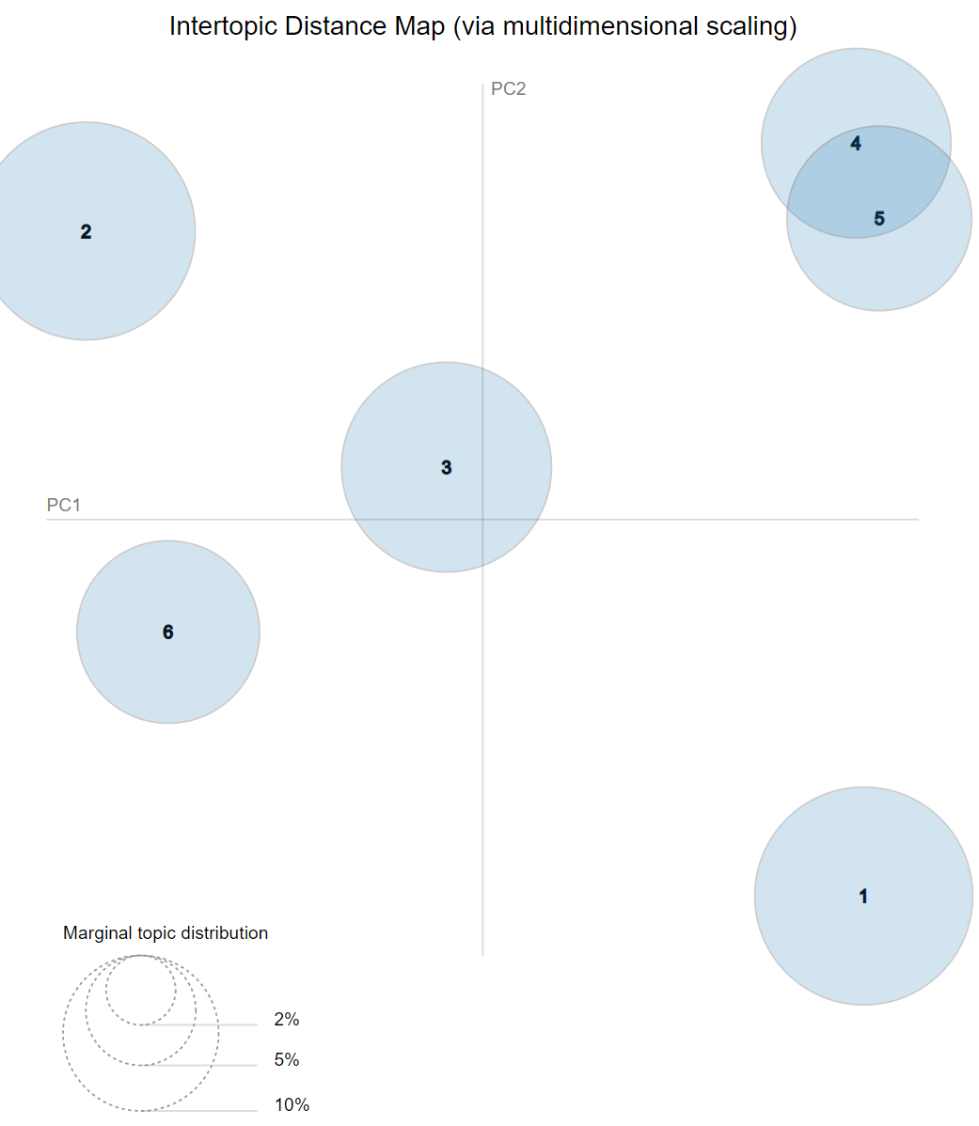
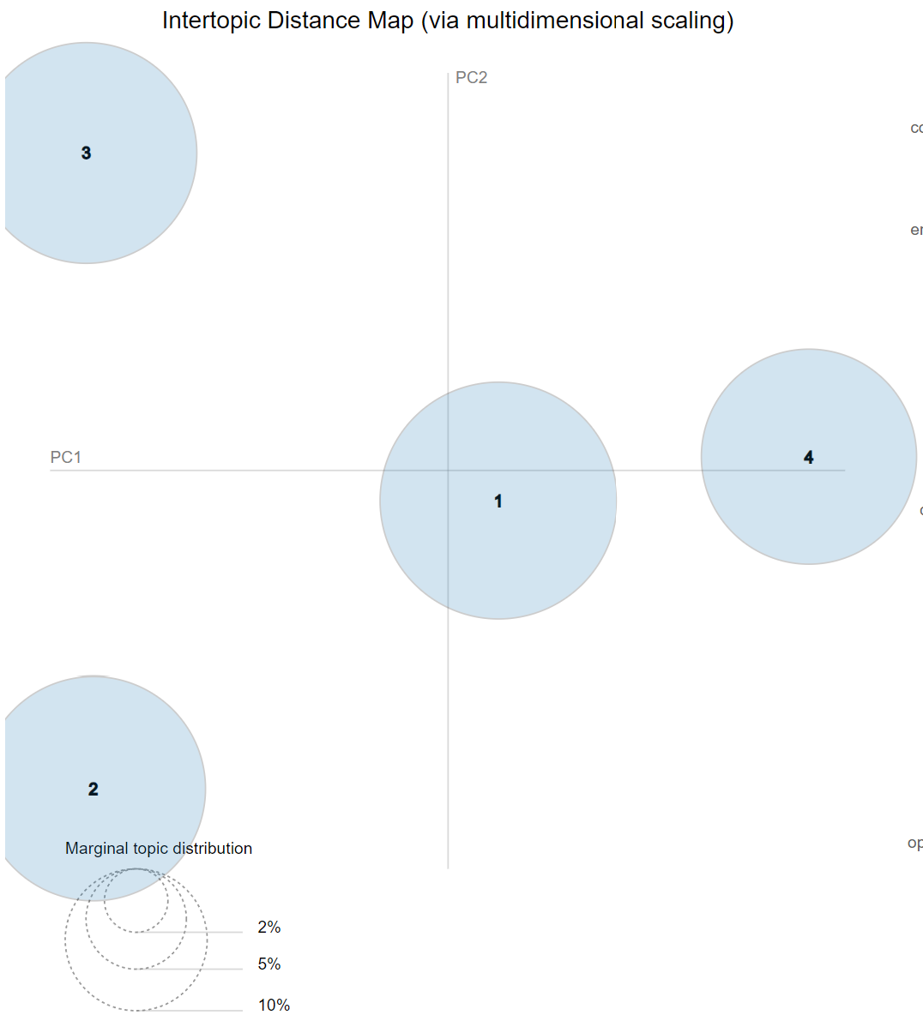
Results
Latent Dirichlet Allocation (LDA)
Glassdoor has 6 topics:
Culture and Values;
Diversity and Inclusion;
Work/Life Balance;
Senior Management;
Compensation and Benefits; and
Career Opportunities
4 Topics:
Compensation and Benefits;
Staff;
Senior Management; and
Work/Life Balance.

Slide 19
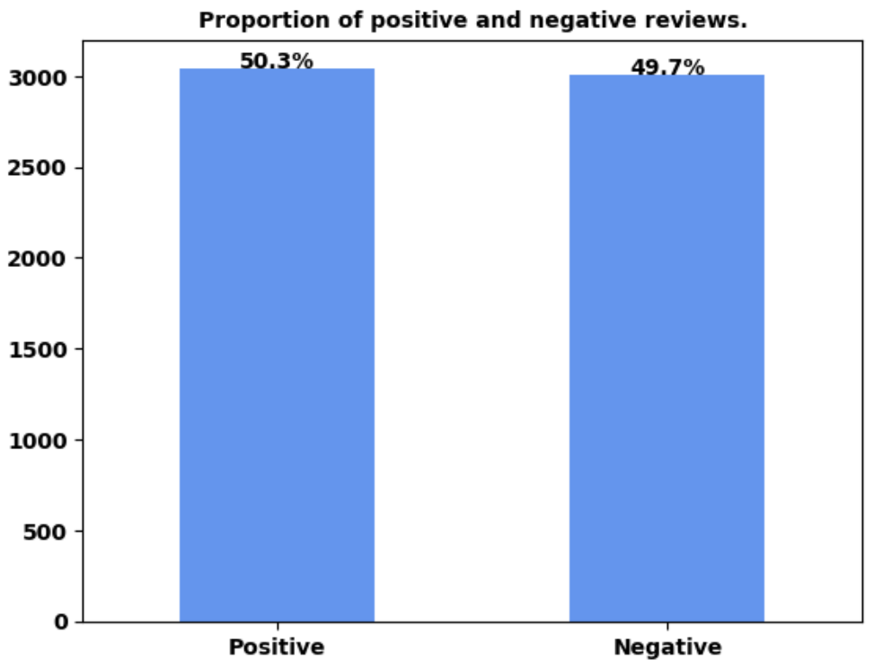
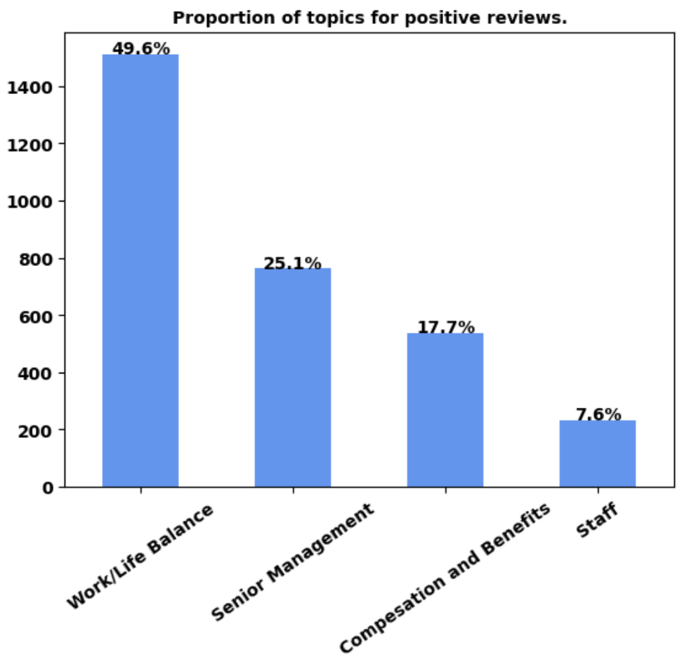
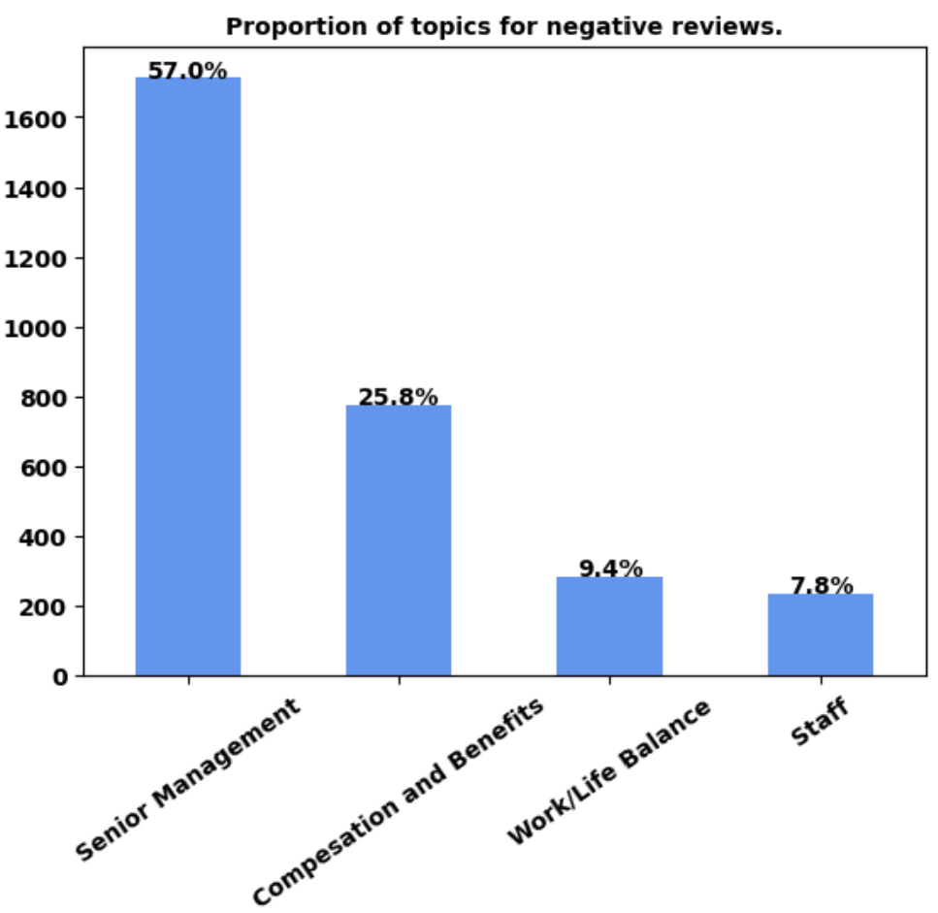
Results
Jupyter notebook: 4 Production.ipynb.
Some analysis given a company:
Some analysis given a new review:

Slide 20
YouTube Video Presentation
YouTube video presentation: https://youtu.be/a0wW95m3q5w

